Slide 1
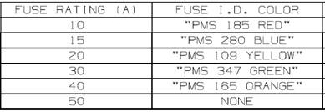

Para fusible 0HEV040.ZXPY & 0HEV040.ZXBD

Slide 2
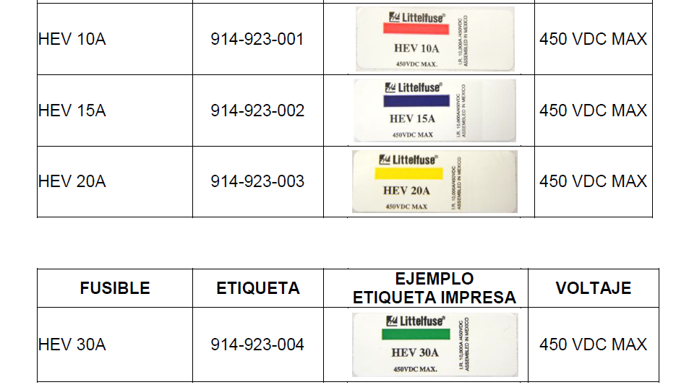

Slide 3
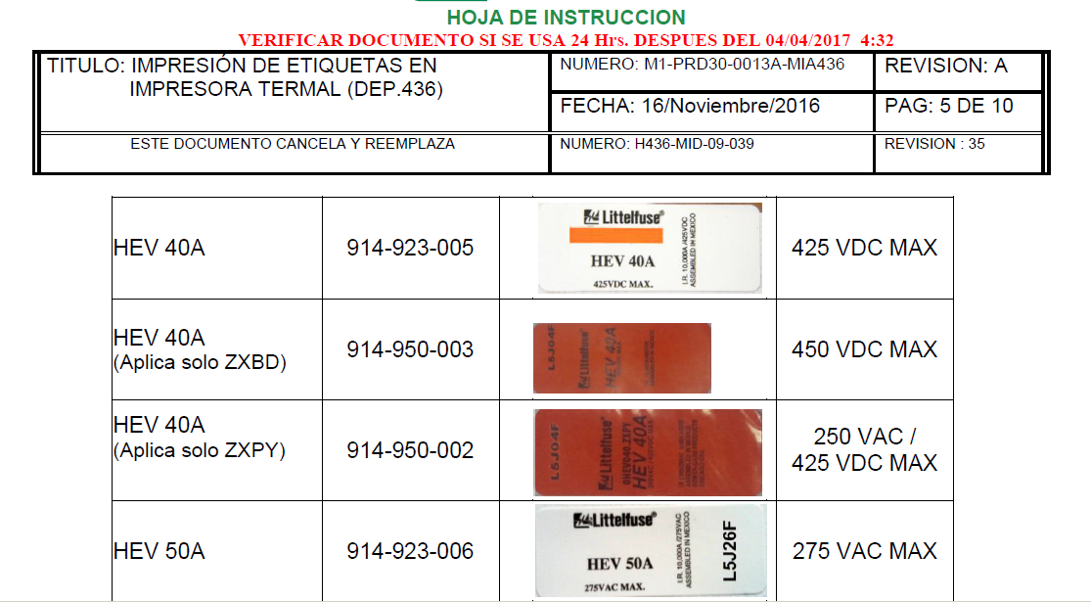

Slide 4

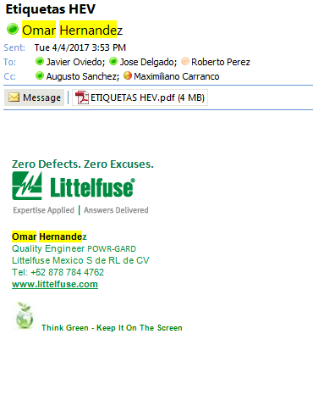

Slide 5
